Slide 1
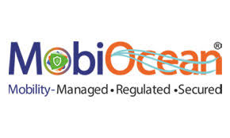

Slide 2
Fintech ?

Slide 3
What is Fintech Stands for
"Fintech" stands for “Financial Technology”. Fintech companies are used the technology to make financial services more efficient. ...
Fintech Companies have been making innovations in POS payments, the main goal of each FinTech company is to make people’s financial life much, much easier (and often times much cheaper).

Slide 4
About Mobiocean
Mobiocean founded in 2016, MobiOcean is a fully Integrated technology solution company. We provides innovative and business oriented Mobility & Payment solutions for retail, small & Medium & Large corporate & government institution. we grew over month on month basis from 2016 and today our solution is being used by Delhi Police, Rajasthan Police, Goa Police, Assam Police for E-Challan and Payments. Airtel and lazer are our partners. Also having distributor network across india .
Our VISION
To become an Industry leader in the Fintech Solution Space
Our MISSION
Provide bespoke solutions to create value in the Fintech Industry
Our VALUES
Ownership, True Partnership, Integrity, Out of box, Speed, Teamwork.

Slide 5
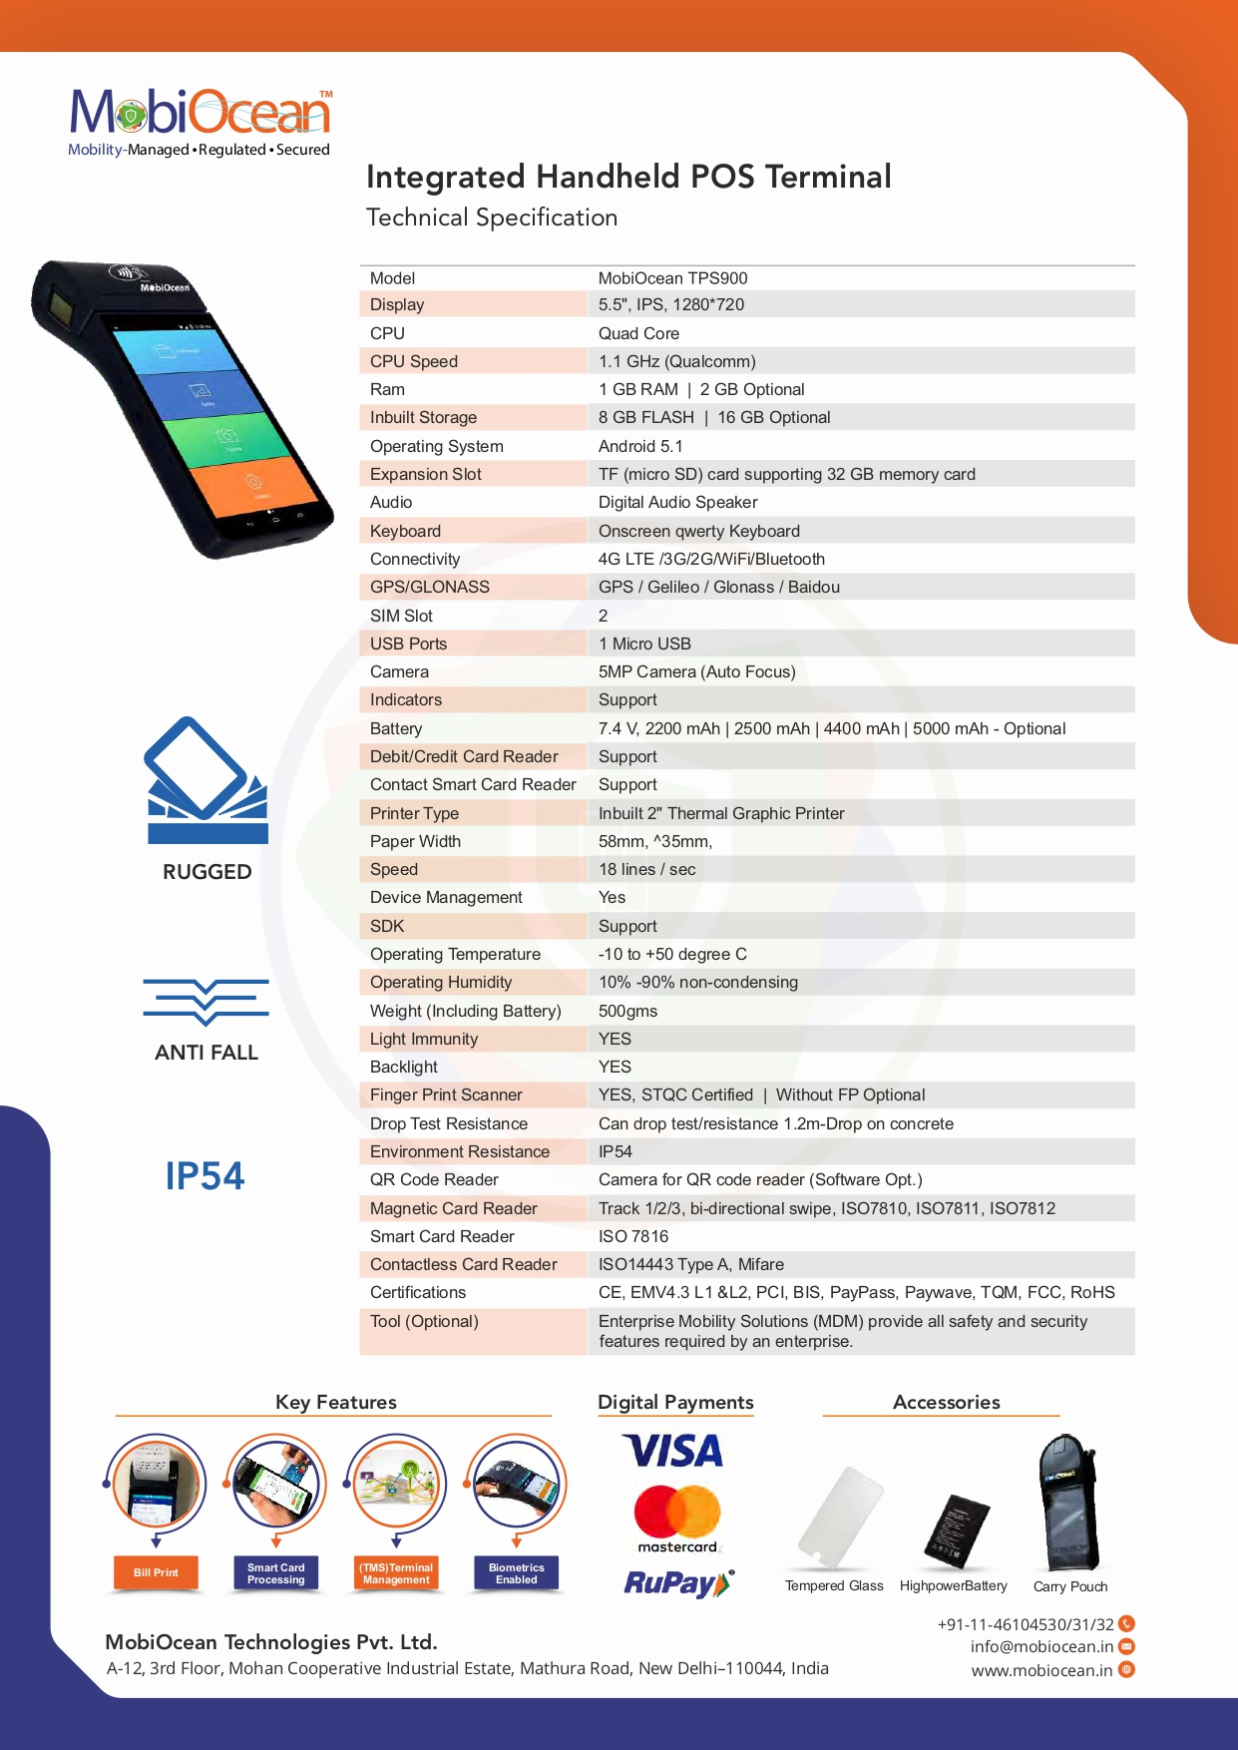
Mobiocean Handheld Device
Model : TPS 900

Slide 6
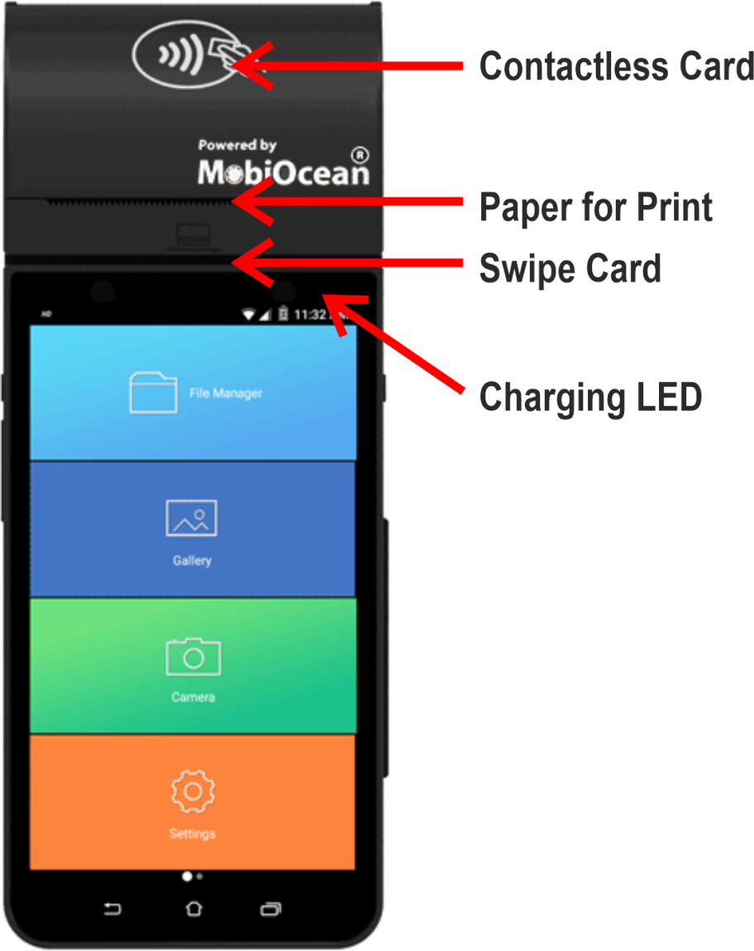
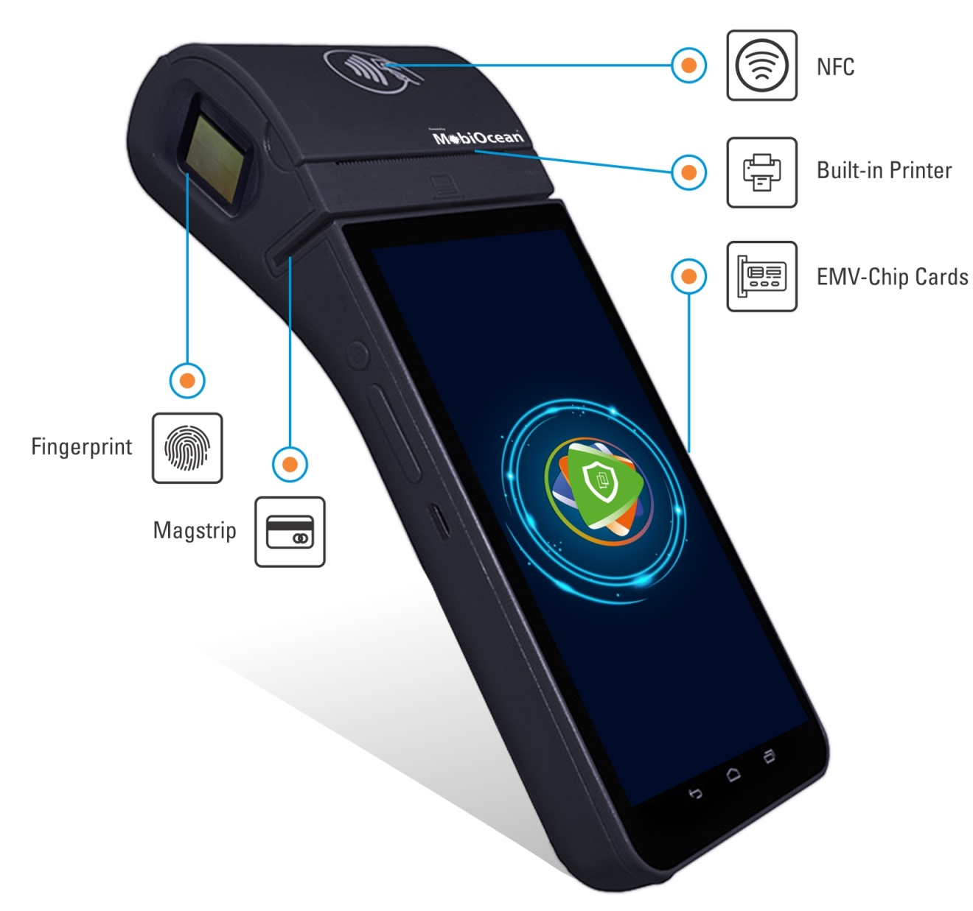

Slide 7
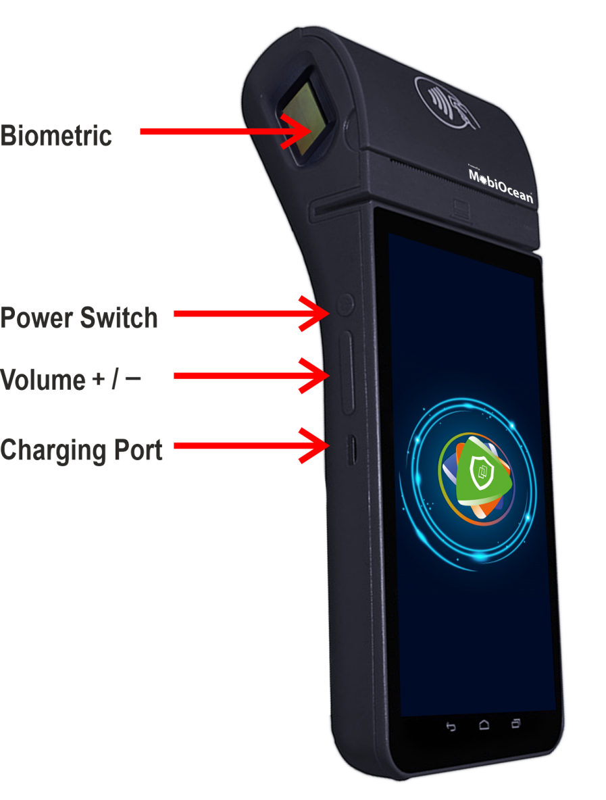
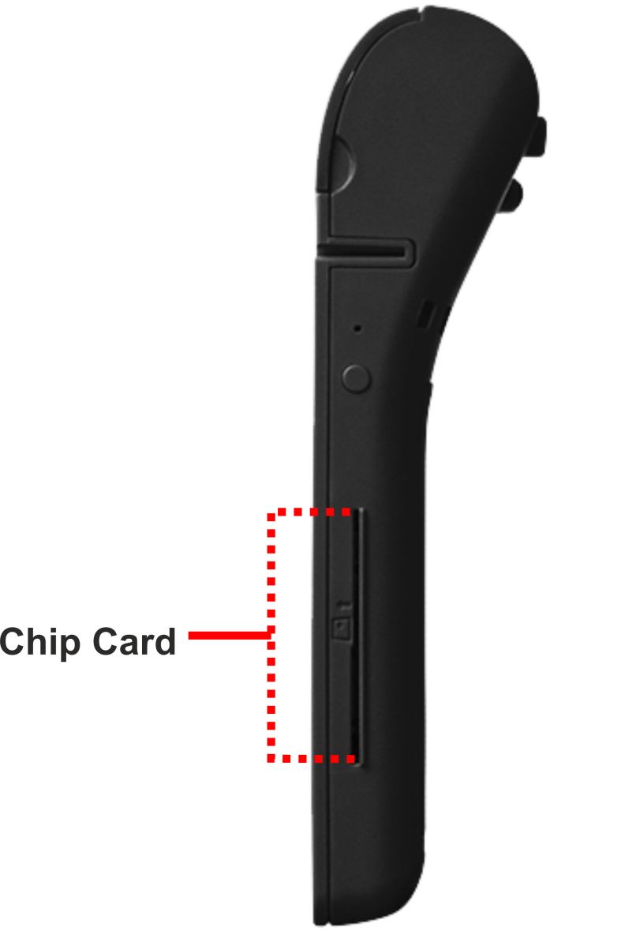

Slide 8
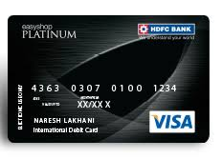
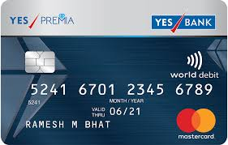
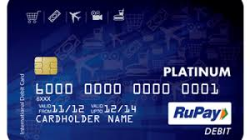
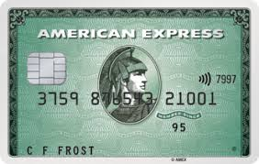
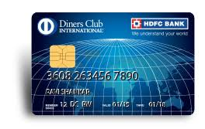
Different types of Cards

Slide 9
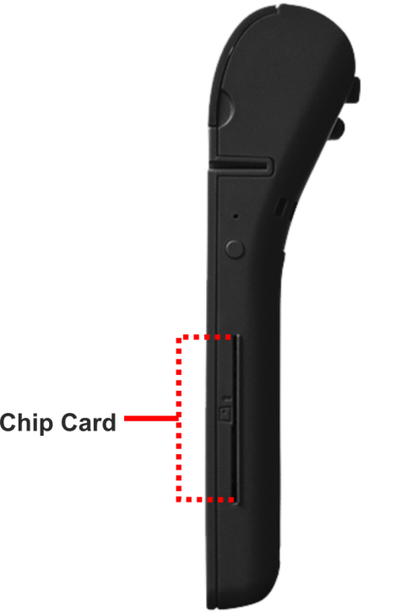
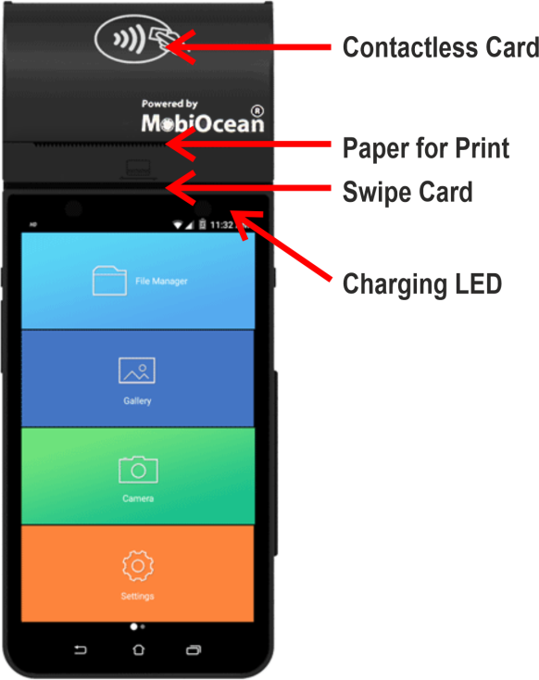
Wifi symbol for contactless card
WE can swipe the card 3 days
Swipe the card
If card is chip base then we can insert the card into the chip slot
Contactless card for making payment without putting security PIN

Slide 10
NFC stands for “Near Field Communication” and, as the name, it enables short-range communication between compatible devices. NFC works on the principle of sending information over radio waves. Near Field Communication is another standard for wireless data transitions.
Contactless Technology :
You might have noticed that your credit and debit cards sometimes get swiped without entering the personal identification number (PIN) if the transaction amount is below ₹2,000. This is possible on cards that have a Wifi symbol. Known as contactless cards, it uses near factor communication (NFC) technology, which allows you to tap and pay at the terminal. You can just wave your card and make the payment. However, the card has to be about 2-cm close to the point of sales (POS) machine. And if the transaction amount is above ₹2,000, the transaction can not made through the tap-and-pay option.
Contactless credit cards have a chip inside them that emits radio waves. ... To pay for something with a contactless credit card, you hold the card near a payment terminal (known as an RFID reader) and it picks up the signal, communicates with the card and processes the payment.
It operates within a radius of about 4 cm and provides a wireless connection between your device and another. This allows for two-way communication, with both devices involved being able to send and receive information.

Slide 11
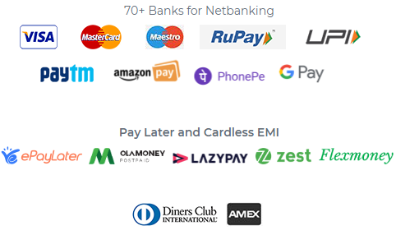
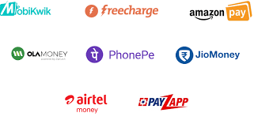
Different payment methods
Credit & Debit cards (Visa, MasterCard, RuPay),
Net Banking, UPI, Digital Wallets, Pay Later and EMI options.
A wallet is a small software program used for online purchase transactions.

Slide 12
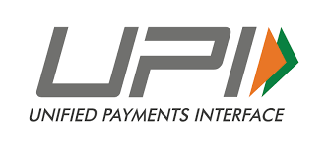
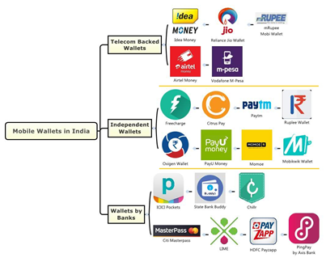
Unified Payments Interface
Unified Payments Interface (UPI) is an instant real-time payment system developed by National Payments Corporation of India facilitating inter-bank transactions. The interface is regulated by the Reserve Bank of India and works by instantly transferring funds between two bank accounts on a mobile platform.
It is a single-window mobile payment system developed by the National Payments Corporation of India (NPCI).Aug 4, 2019

Slide 13
Swiping Charges
The term swipe Charges refers to the hidden cost paid by merchants to card-issuing banks and credit card companies for processing credit card and debit card transactions.
MDR is the cost paid by a merchant to a bank for accepting payment from their customers via digital means. The merchant discount rate is expressed in percentage of the transaction amount. It is also applicable for online transactions and QR-based transactions. The merchant discount rate is the rate charged to a merchant for payment processing services on debit and credit card transactions.
MDR charges are usually shared in pre-agreed proportion between the bank and a merchant and is expressed in percentage of transaction amount. ...
For example
Debit Card
< 2000 = MDR = Zero
> 2000 = 0.4%
Question : for Rs. 2100 how much the MDR ?

Slide 14
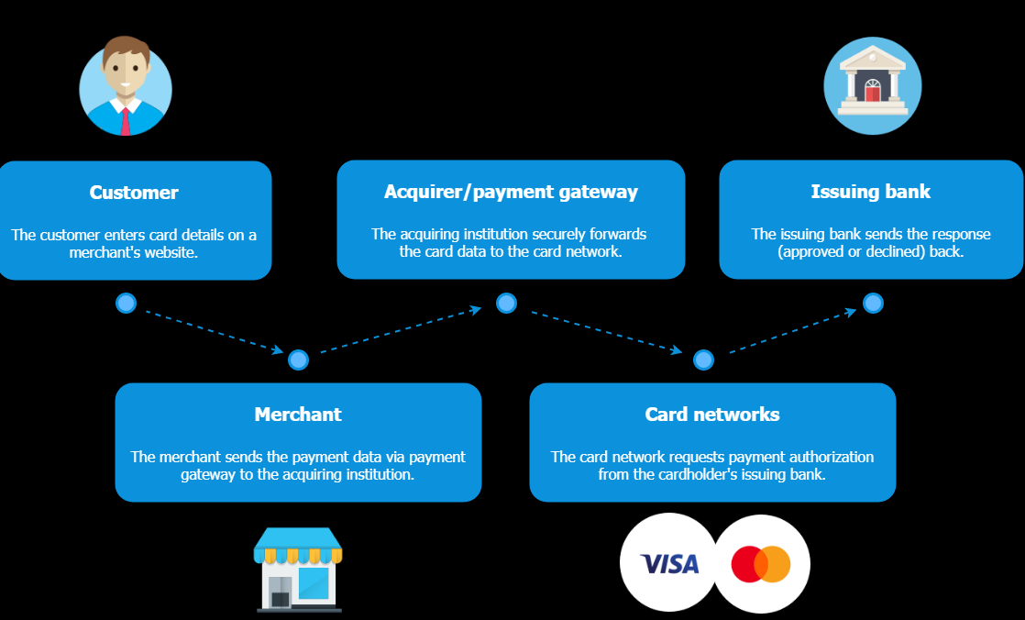
How Card transaction happens ?
When the customer makes a payment with their card, the card data is sent to the payment gateway
The payment gateway transfers the details to your acquiring bank which forwards the payment request to the card networks (Visa or MasterCard).
The card network submits the transaction to the customer’s issuing bank for authorization.
The issuing bank checks the transaction data and the customer’s balance. If everything is fine, the issuing bank forwards the transaction approval response.
The customer then sees that their payment was successful, and the order is being prepared.
The process does not end here but proceeds to clearance. After the payment gateway sends the transaction information to the card networks, the card networks start the movement of funds from the cardholder to the merchant’s acquiring bank.
card processing bank
T+1 T stands for transaction date, which is the day the transaction takes place. The numbers 1, 2 or 3 denote how many days after the transaction date the settlement or the transfer of money and security ownership takes place.

Slide 15
Finger Print
Human fingerprints are practically unique, which is why they’re successful at identifying individuals. Fingerprint scanners work by capturing the pattern of ridges (Lines )and valleys on a finger. The information is then processed by the device’s pattern analysis/matching software, which compares it to the list of registered fingerprints on file. A successful match means that an identity has been verified, thereby granting access. fingerprint scanners are the oldest method of capturing and comparing fingerprints.

Slide 16
Micro ATM
Micro ATMs are card swipe machines through which banks can remotely connect to their core banking system (CBS) (server where all the information). This machine comes with a fingerprint scanner attached to it. In other words, micro ATMs are handheld point of sale terminals used to disburse cash in remote locations where bank branches cannot reach. Micro ATMs are similar to point of sale (PoS) terminals and are a doorstep mobile banking arrangement cum-mobile ATM device. This machine comes with a fingerprint scanner attached to it and are linked to Aadhaar number.
Micro ATMs would particularly help address the problems that people are facing in rural and semi-urban areas, where the ATM network is not as strong currently
ATMs need at least 80-100 transactions a day to be viable as they costs several lakh and have monthly operating expenses of close to Rs 30,000 after taking into account rental, telecom charges, AMC costs, electricity expenses and security guard.
A micro ATM costs less than Rs 20,000. Also because it is portable it can be with a shopkeeper or Bank Agent. Since connectivity is through GSM, Anyone can carry it and travel village to village at set times.

Slide 17
Micro ATMs a big hit in rural India, transactions in May touch 33.5 million
With an annual growth rate of 150% since 2016, the Aadhar-Enabled Payments Channel (AEPS), which falls under the broader category of micro-ATMs, has emerged as one of the fastest growing payments systems in the country, second only to the Unified Payment Interface (UPI) system in terms of annual volume growth. While UPI addresses just the top 80 million customers, AEPS caters to 800 million customers who are not reached by banks directly. With expanded driving force by the government on Direct Benefit Transfers (DBT) for delivering the government schemes to the citizens, such access infrastructure can go far in satisfying financial inclusion mandate of the government.
Benefits of Micro ATM
Encourages financial inclusion by providing rural population easy access to micro banking services in effective manner
Micro ATM can be significant tool in extending banking services in the remote areas
It is a low cost and easy alternative to the regular ATM
These devices are portable, thus, increasing the reach of the services
Easy to carry and setup anywhere in the remote area
UIDAI complaint, biometric enabled secured transactions
Micro ATMs are interoperable devices that can work for any bank

Slide 18

AEPS :
AEPS is nothing but an Aadhaar-enabled payment system through which you can transfer funds, make payments, deposit cash, make withdrawals, make enquiry about bank balance, etc. ... Customers can carry out all transactions through a Business Correspondent (BC) or bank agent through a micro ATM.
Aadhaar-based payments, which are managed by the National Payments Corporation of India, allowed customers to operate bank accounts using the 12-digit ID and biometrics.
AEPS allows customers to make payments using their Aadhaar number and by providing Aadhaar verification at point of Sale (PoS) or micro ATMs . This is a simple, secure and user-friendly platform for financial transactions. This is another initiative taken by the National Payments Corporation of India (NPCI) to encourage cashless transactions in India. In order to use AEPS, your bank account must be linked to Aadhaar.
How to use AEPS?
Step 1: Go to a micro ATM or banking correspondent
Step 2: Provide Aadhaar number and bank name
Step 3: Choose the type of transaction you want to make
Step 4: Provide verification through fingerprint/iris scan
Step 5: Collect your receipt

Slide 19
What is Aadhaar?
Ans: Aadhaar is and unique number that is assigned to residents of India by the Unique Identification Authority of India (UIDAI).
Who can use AEPS?
Ans: All Indian residents holding a valid Aadhaar card and a bank account can use this payments service.
How can a user enable this service?
Ans: To start using AEPS, first link your bank account with your Aadhaar number. Then, contact your bank and let them know that you want to start using AEPS.
Should the payee/beneficiary also have AEPS to receive funds?
Ans: This is not necessary.
Is it possible to link more than one bank account to your Aadhaar card?
Ans: Yes. This can be done.
Can those without Aadhaar cards use this service?
Ans: No.
What type of bank account do you need to have for AEPS?
Ans: The bank account needs to be linked with your Aadhaar.
What is a business correspondent?
Ans: A business correspondent is nothing but an approved bank agent offering terminal or micro ATM services to banks.

Slide 20
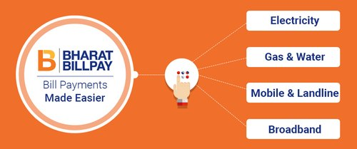
The Bharat Bill Payment System (BBPS) is an integrated bill payment system, operating in India. It offers bill payment service to customers through a network of agents who are registered members, known as Agent Institutions (AI). This system enables multiple payment modes and provides instant confirmation of payment.
What are benefits of using BBPS?
The biggest advantage is that the bill can be paid anywhere and anytime..
Is there any charges for making payment using BBPS?
Currently no charges are being levied; however, the same is subject to change as per BBPS
standards/rules/guidelines.
What are the timings for BBPS transactions?
BBPS services are available 24 hours of the day, all days of the week, throughout the year
including all public holidays.
How long will it take for the payment confirmation?
Payment confirmation shall be received on registered mobile / e-mail (As provided while
making bill payment) upon successful completion of the transaction instantaneously.

Slide 21
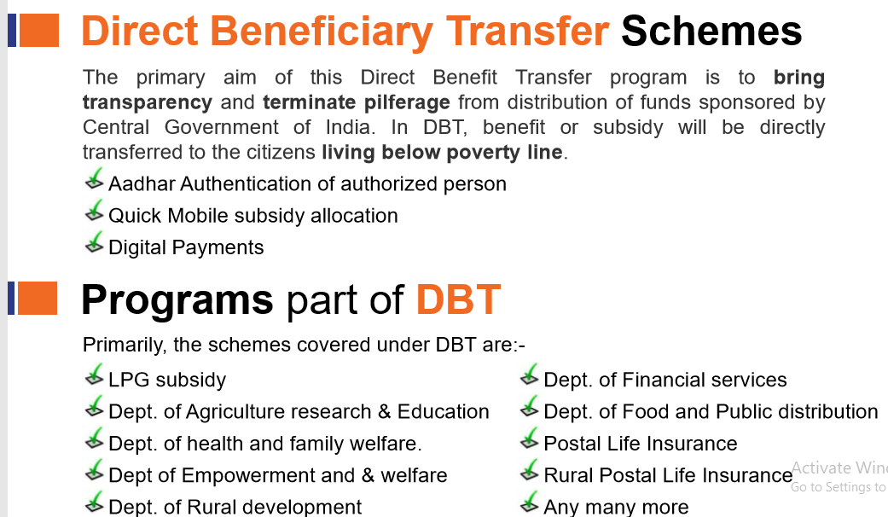
What is DBT (Direct Benefit Transfer)?
DBT (Direct Benefit Transfer) is a scheme launched by Government of India to transfer the benefits and subsidies of various social welfare schemes like LPG subsidy, MNREGA payments, Old Age Pension, Scholarships etc. directly in the bank account of the beneficiary.

Slide 22
Scope

Slide 23
Smart Cities Project
Smart Cities objective is to drive economic growth and improve the quality of life of people by development using smart technologies, the technology that leads to Smart outcomes.
Smart city would include:
Adequate water supply alongwith smart billing with Doorstep payment Collection solution
Adequate Piped GAS supply alongwith smart Doorstep payment Collection solution
Assured electricity supply with smart billing Doorstep payment Collection solution
Sanitation, including solid waste management alongwith smart Doorstep payment Collection solution
Efficient public transport with smart billing with Digital payment Collection solution
Smart billing and Doorstep payment Collection for Property Tax etc
E-challans

Slide 24
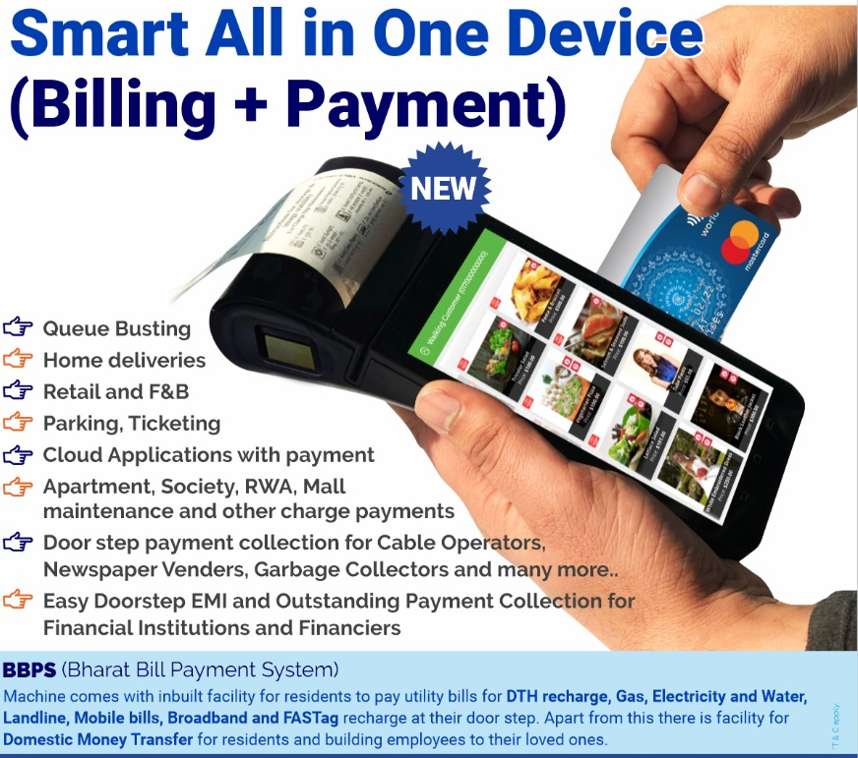

Slide 25
Aaganwari Schemes
2. ENAM
3. Fertilizer under DBT
4. E Challan
5. Micro ATM
Department of Post
India Post Banking
Cooperative Banks
Grammin Bank

Slide 26
Bus e-ticket under Transport Department
7. Electricity Board
8. Municipal corporation
9. PDS under food & civil supplies Department
10. CSC -Common Service Centre
11. Excise department for there wine shops

Slide 27
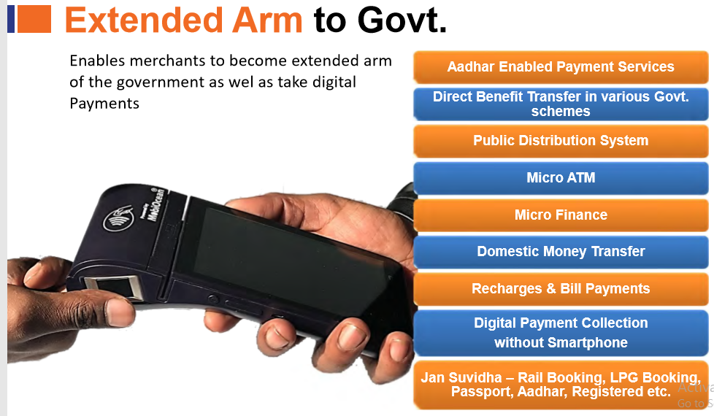

Slide 28
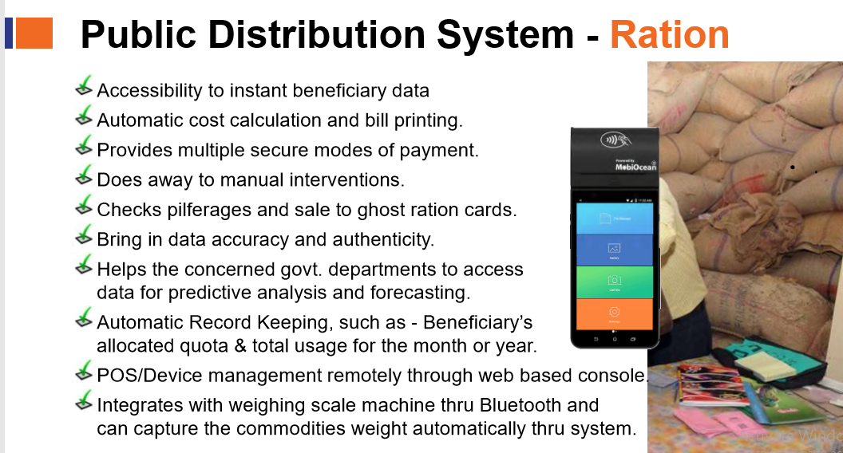

Slide 29
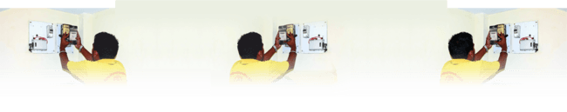
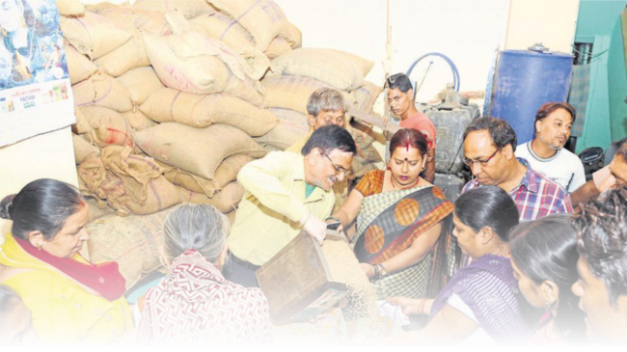
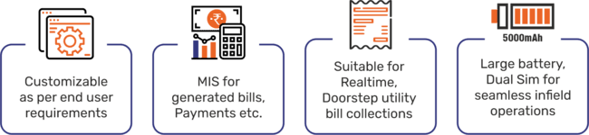
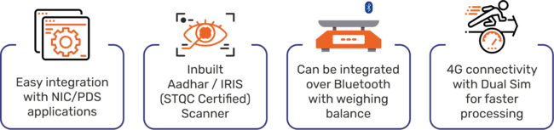
1. Spot Billing
Perfect solution for door-step digital payments such as Home delivery, bill collections and much more.
2. Fair Price Shop
From beneficiary authentication to digital payments, one-stop solution for large scale deployments.
Watch training video on Youtube : https://youtu.be/02icbB4UXks
Watch training video on Youtube : https://youtu.be/amsYVWhslNs
Multi-payment methods available:

Slide 30
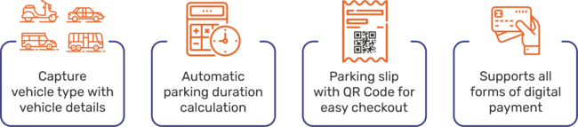
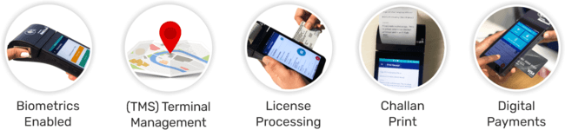
3. Smart Parking
Solutions ready for NCMC and RFID tag reading with inbuilt digital transaction capabilities.
4. E-Challan
Long battery life, 4G connectivity, solution that fulfils all the needs of in-field operations.
Watch training video on Youtube:
https://youtu.be/02icbB4UXks
Watch training video on Youtube:
https://youtu.be/iDq8KGBFTLs

Slide 31
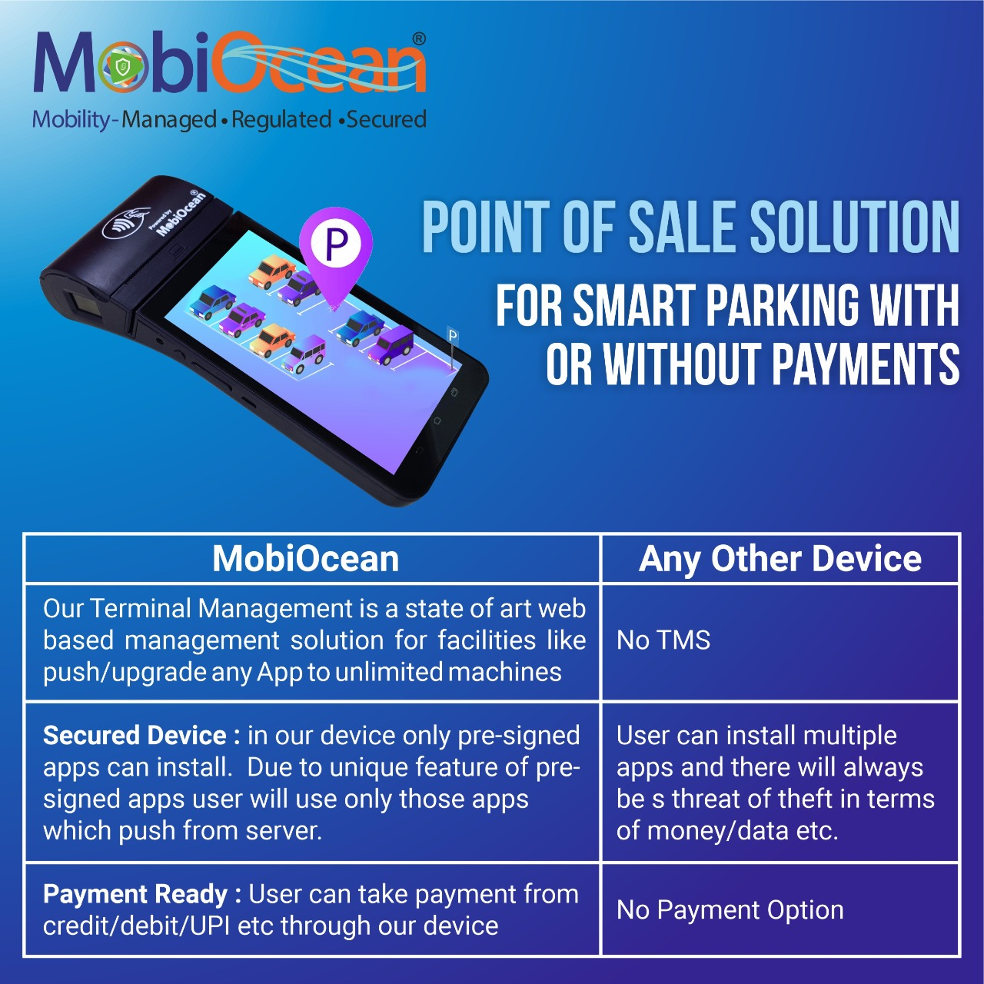

Slide 32
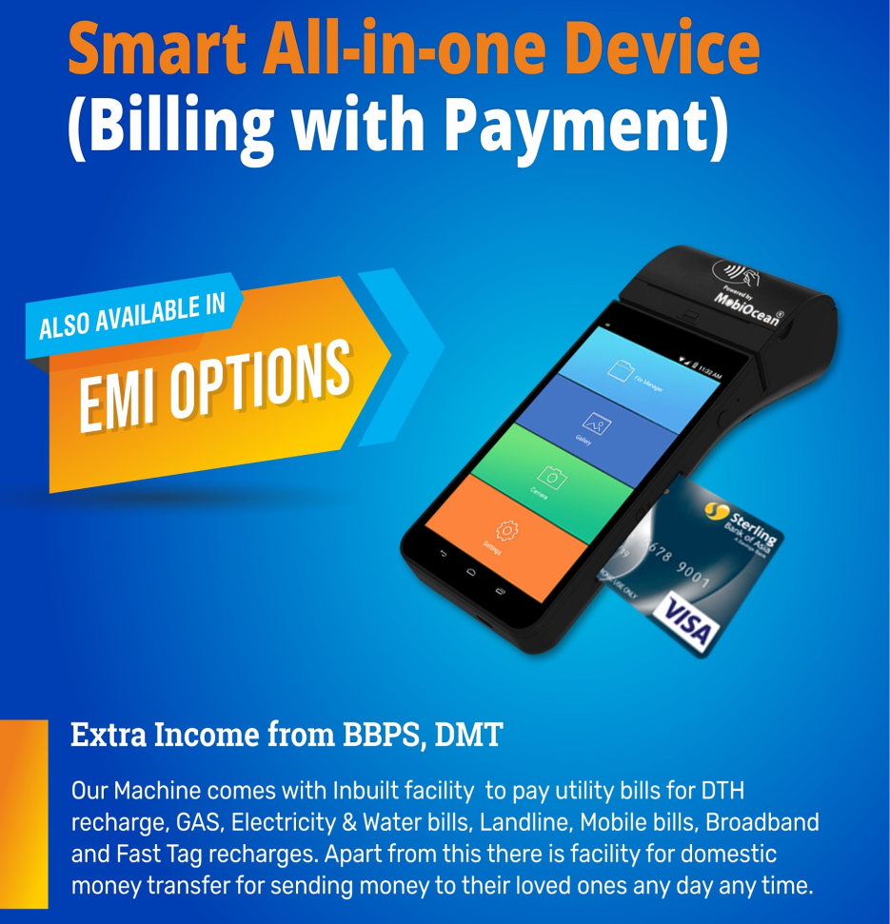

Slide 33
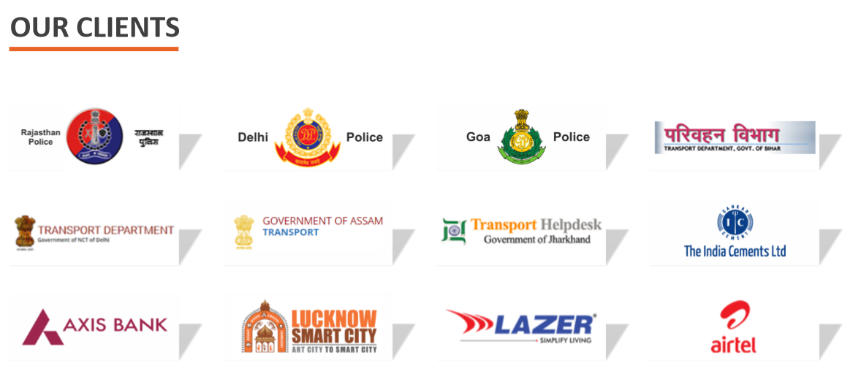

Slide 34
Thank You

